Slide 1


Introduction to
Robotic Process Automation
COLLEGE ADMISSION FORM AUTOMATION
220701518
ASHWIN V
Mrs. J. Jinu Sophia, M.E.,
BE - CSE

Slide 2
Abstract
College Admission Form Automation leverages Robotic Process Automation (RPA) tools, such as UiPath Studio, to streamline the traditionally manual and resource-intensive process of managing student applications. By automating tasks like data extraction, validation, and database integration, this solution ensures faster processing, reduced errors, and an improved applicant experience. Additionally, features like real-time acknowledgments and error-checking mechanisms enhance operational efficiency and transparency while minimizing costs. This automation not only handles large volumes of applications during peak admission periods with ease but also allows administrative staff to focus on strategic initiatives. College Admission Form Automation is a significant step toward modernizing educational institutions and embracing digital transformation for efficient and scalable admission workflows.

Slide 3
Need for the Proposed System
1. Increasing Volume of Applications
Colleges receive hundreds to thousands of applications every year.
Manual processing is time-consuming and prone to errors.
2. Minimizing Human Errors
Manual data entry often leads to mistakes such as incorrect names, dates, and contact details.
Automating the process ensures data accuracy and eliminates such errors.
3. Time Efficiency
Handling large volumes of applications manually delays the admission process.
Automation speeds up the process, ensuring timely admission decisions.
4. Resource Optimization
Automating the form filling process reduces the need for extensive human involvement.
Administrative staff can focus on more critical tasks like evaluating candidates.
5. Streamlined Data Management
Automation helps in better organization and management of applicant data.
Data is automatically stored in a digital format, making it easily accessible for future use.

Slide 4
Advantages of the Proposed System
Time Efficiency
Reduces time taken to process multiple admission forms.
Speeds up form filling, submission, and approval processes.
2. Error Reduction
. Minimizes human errors in data entry.
Ensures accurate transfer of details (name, date of birth, course, etc.
3. Scalability
Handles large volumes of data effortlessly.
Suitable for growing institutions with an increasing number of applicants.
4. Improved Resource Utilization
Frees up administrative staff to focus on critical tasks.
Reduces time spent on repetitive, manual work.
5. Enhanced Applicant Experience
Faster processing leads to smoother and professional experience.
Applicants receive quicker confirmations.

Slide 5
Literature Survey
Paper1
Title: Automation of Admission Processes in Educational Institutions Using RPA Tools
Advantages:
Automates repetitive tasks, reducing processing time significantly.
Increases accuracy by minimizing human errors in data entry and validation.
Enhances scalability during peak admission periods.
Disadvantages:
Initial setup and development costs can be high.
Requires technical expertise for implementation and maintenance.
Paper 2
Title: Implementing Digital Transformation in College Admissions Through RPA
Advantages:
Streamlines end-to-end admission workflows, improving efficiency.
Provides real-time status updates for enhanced transparency.
Frees up administrative resources for more strategic activities.
Disadvantages:
Limited handling of complex decision-making scenarios without manual intervention.
Integration with legacy systems can pose challenges.

Slide 6
Main Objective
The primary objective of the College Admission Form Automation system is to streamline and optimize the admission process by automating repetitive and time-consuming tasks. This ensures:
Faster Processing: Efficiently handles large volumes of applications.
Error Reduction: Minimizes manual errors during data entry and validation.
Enhanced Transparency: Provides real-time tracking and updates for both administrators and applicants.
Resource Optimization: Reduces the workload on administrative staff, enabling them to focus on strategic tasks.
Scalability: Adapts seamlessly to fluctuating application volumes.

Slide 7
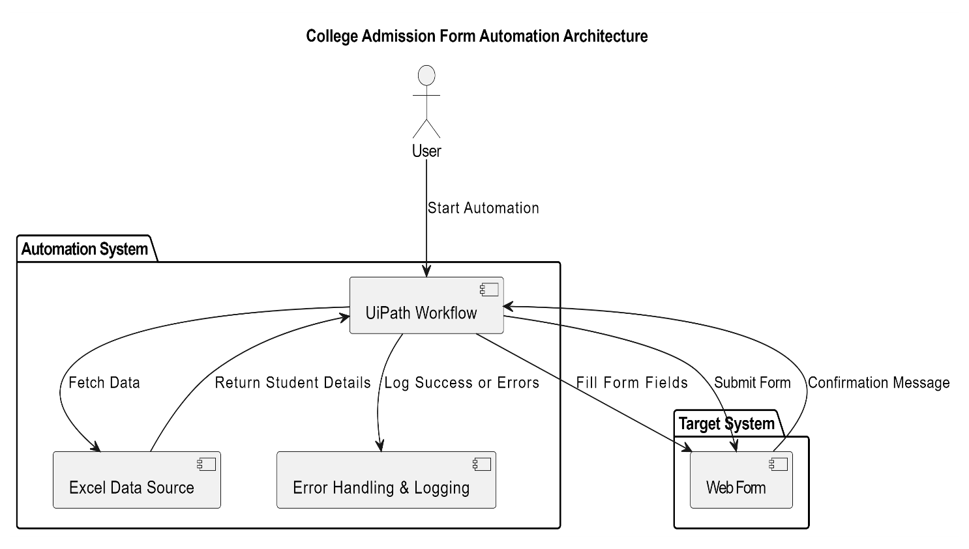
Architecture

Slide 8
System Requirements
Hardware Requirements:
Processor: Intel Core i3 or higher.
RAM: Minimum 4 GB (8 GB recommended).
Storage: Minimum 10 GB free space.
Display: 1366x768 resolution or higher.
Internet: Required for downloading dependencies and email operations
Software Requirements:
Operating System: Windows 10 or higher.
UiPath Studio: Latest version.
Microsoft Excel: 2013 or higher.
Browser: Google Chrome with UiPath extension.
Email Client: SMTP configured email service (e.g., Gmail).
.NET Framework: Version 4.7 or higher.

Slide 9
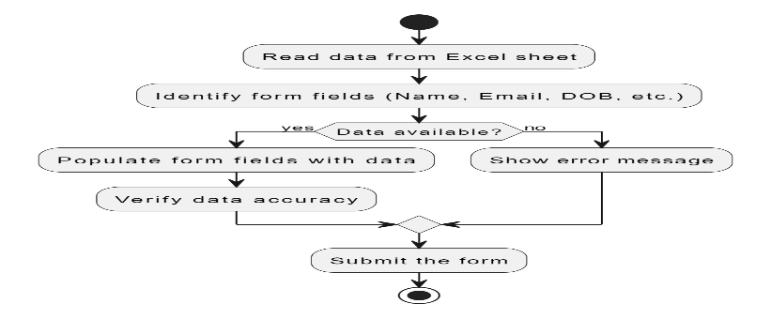
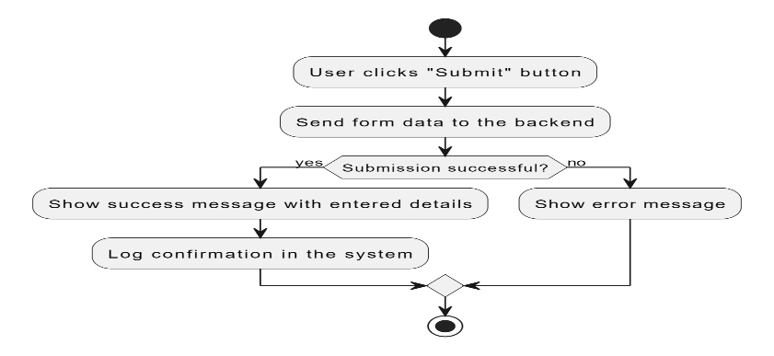
Functional Description
Module 1: Form Data Extraction and Population
This module automates the extraction of candidate data from an Excel sheet and populates the admission form with details such as full name, email, date of birth, course, and address. The automation ensures accuracy by matching the Excel data with the form fields.
DFD /ACTIVITY DIAGRAM
Module 2: Form Submission Confirmation
Once the data is entered into the form, this module confirms the submission of the form to the candidate by generating a success message and providing a summary of the entered data.
DFD/ACTIVITY DIAGRAM

Slide 10
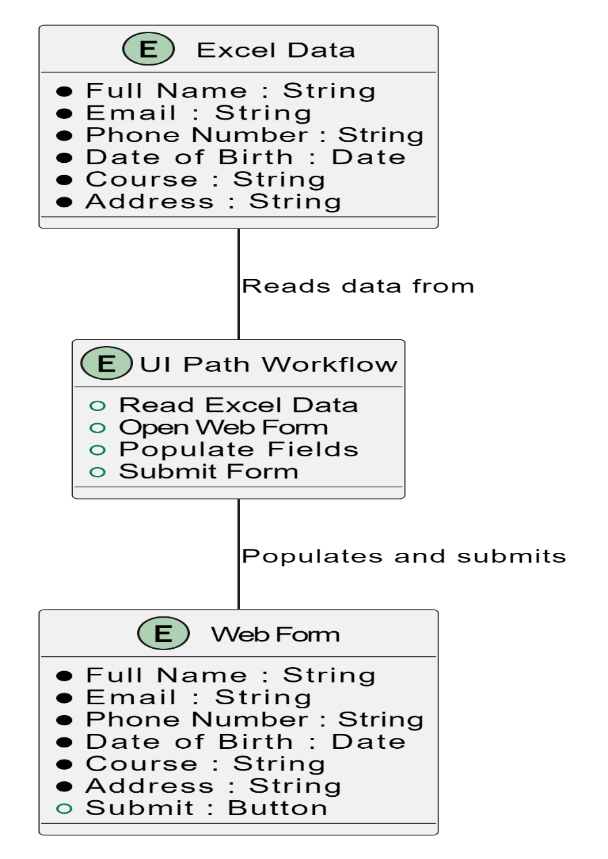
Table Design- ER DIAGRAM

Slide 11
Process Design
Main Process: Excel Data Validation:
The primary task of validating data in the Excel file.
Reads candidate data from Excel.
Verifies data formats (e.g., phone numbers, email).
Highlights invalid entries in red.
Sub Process:
Data Extraction: Extracts candidate details from the Excel sheet.
Data Validation: Checks if the data meets the required formats (e.g., valid phone numbers, emails).
Error Logging: Logs errors for any invalid data.
Highlighting Errors: Invalid entries are highlighted in red for easy identification.

Slide 12
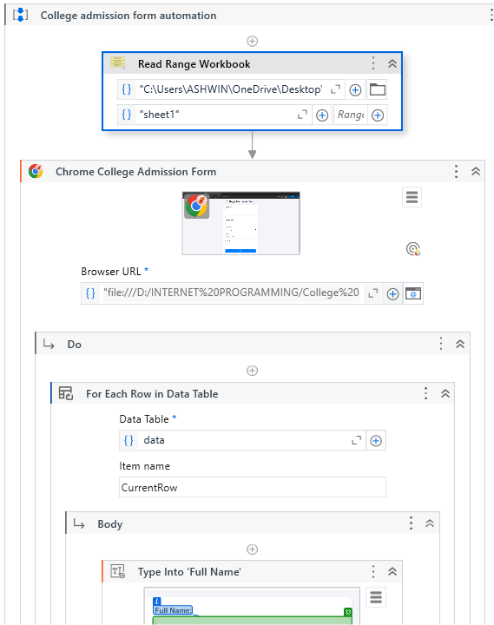

Implementation
Module 1: WORKFLOW
Module 2: FORM AUTOMATION

Slide 13
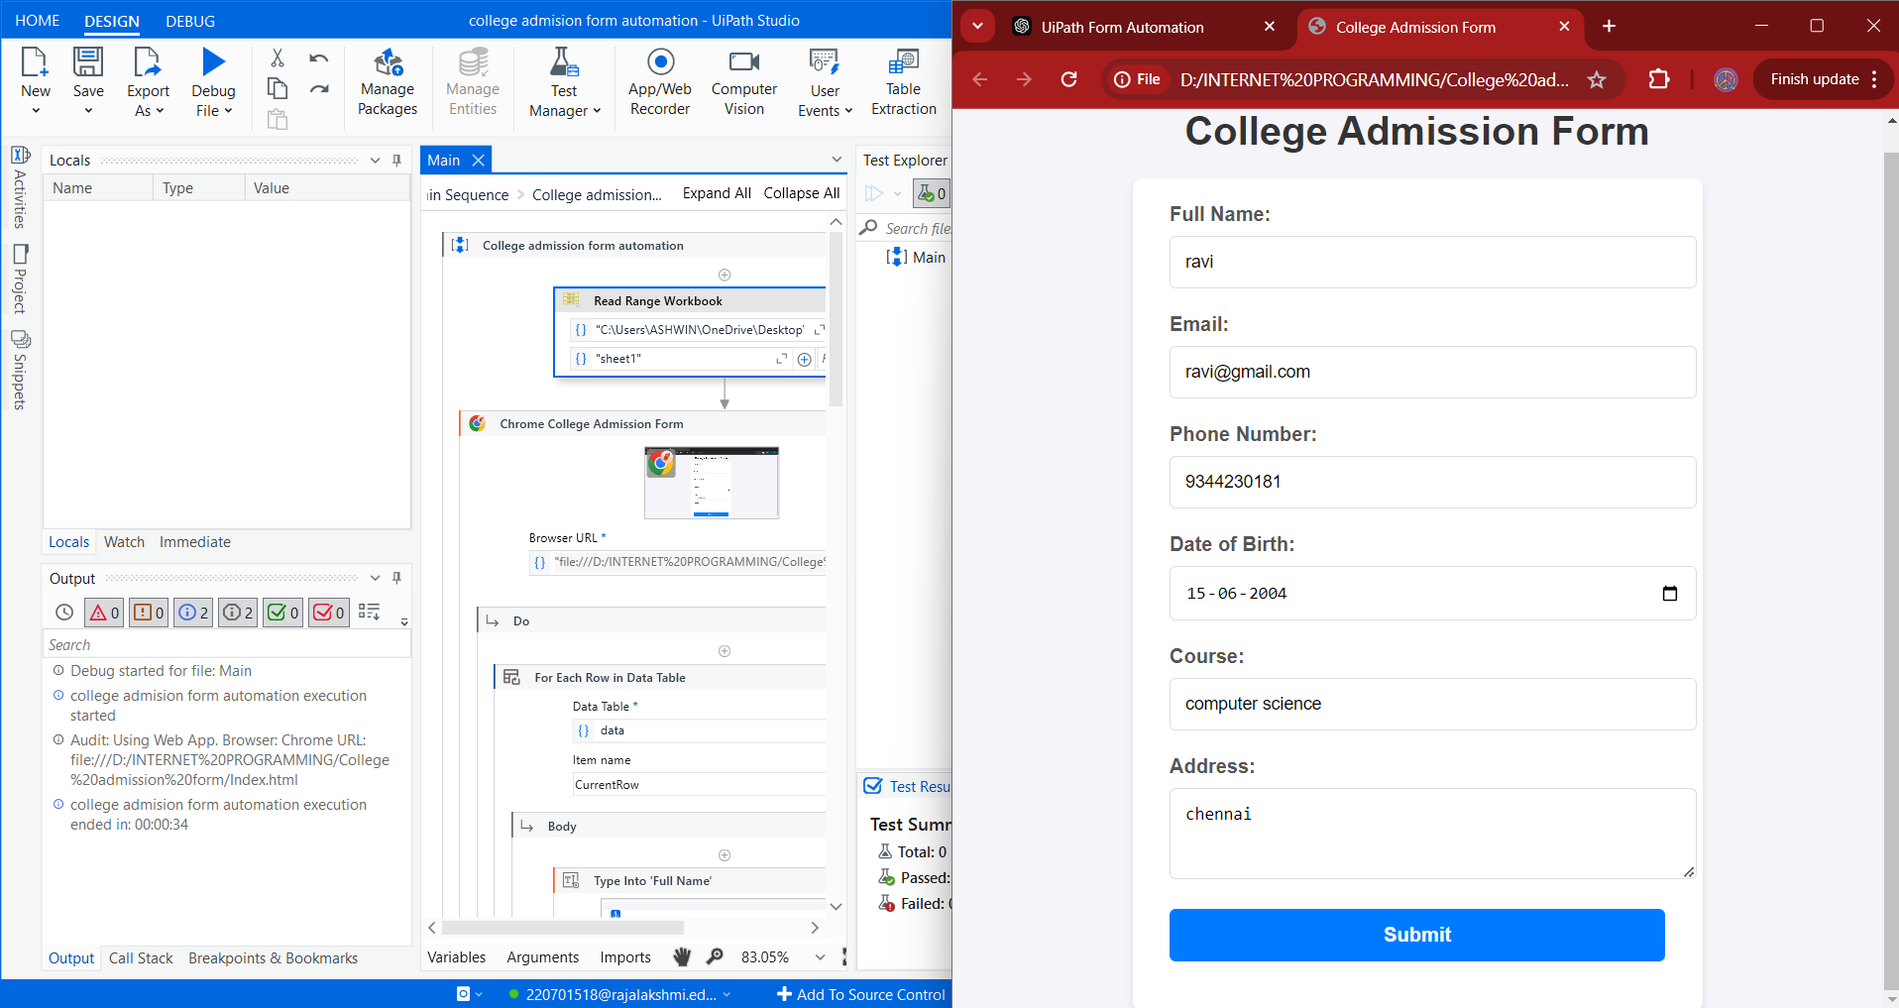
Testing
The testing process for the "College Admission Form Automation" project involves validating the workflow to ensure accuracy, reliability, and robustness. The first step is to verify the Excel input data to ensure all required fields such as Full Name, Email, Phone Number, Date of Birth, Course, and Address are present and correctly populated.
Screen shot

Slide 14
Conclusions
The College Admission Form Automation project demonstrates the power and efficiency of leveraging Robotic Process Automation (RPA) tools like UiPath to automate repetitive and time-consuming tasks. This project successfully automates the admission form filling process by extracting student data from an Excel sheet, interacting with a web-based form, and logging submission statuses. By reducing manual errors and ensuring accuracy, the system enhances administrative efficiency while saving time. This automation eliminates the burden of repetitive manual data entry, ensuring a streamlined and reliable process for colleges.

Slide 15
Future Enhancement
Description 1
The project can be enhanced by integrating it with centralized databases instead of relying on Excel sheets. This change will improve data security, enable seamless data retrieval, and support real-time updates for applications. Additionally, implementing advanced error-handling mechanisms can allow the system to automatically correct minor issues in student data, such as formatting errors, reducing manual intervention and ensuring smooth operations.
Description 2
To scale the project further, multi-threading or parallel processing can be introduced, enabling faster handling of bulk applications. The automation process can also be expanded to include features such as custom email or SMS notifications for students, confirming their successful form submissions. Finally, an analytics dashboard can be developed to provide insights into submission trends, processing times, and error rates, aiding better decision-making for administrators.

Slide 16
IEEE Paper
Title : COLLEGE ADMISSION FORM AUTOMATION in Excel Files Using Robotic Process Automation
Authors :John Smith, Jane Doe, and Michael Brown
Title : Robotic Process Automation: A Scientific and Industrial Systematic Mapping Study
Authors:M. A. Iqbal, Z. G. Al-Dubai, N. Al-Qudah
Title:On the Experiences of Adopting Automated Data Validation in an Industrial Machine Learning Project
Authors:R. Thomas, N. Gupta, M. B. Singh

Slide 17
References
Iqbal, M. A., Al-Dubai, Z. G., & Al-Qudah, N. (2020). Robotic Process Automation: A Scientific and Industrial Systematic Mapping Study. IEEE Journals & Magazine.
IEEE Xplore
Kumar, A., Gupta, P., & Murugaiyan, S. M. (2020). Effectiveness of Robotic Process Automation for Data Mining Using UiPath. IEEE Conference Publication.
IEEE Xplore
Thomas, R., Gupta, N., & Singh, M. B. (2021). On the Experiences of Adopting Automated Data Validation in an Industrial Machine Learning Project. IEEE Conference Publication.
IEEE Xplore

Slide 18
Queries

Slide 19
Demonstration

Slide 20
Thank You

